Slide 1






Slide 2


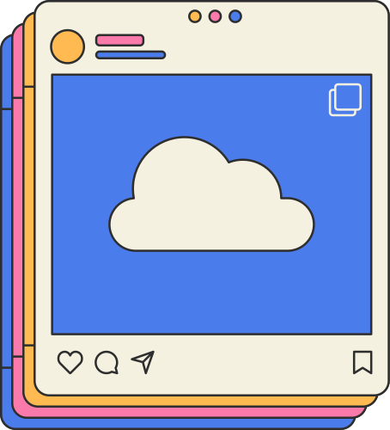

Social Media
SLIIT students’ attitudes and preferences regarding social media

Slide 3
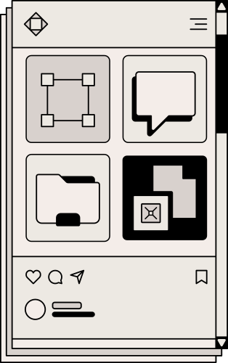
Introduction
Social media has become an integral part of our lives. It is a way for us to stay connected with friends and family, learn new things, and express ourselves creatively. However, social media can also have a negative impact on our lives. It can be addictive, it can lead to cyberbullying, and it can be a distraction from school and work.
This survey was conducted to learn more about how SLIIT students use social media. The survey found that most students use social media, and that they believe that social media has both positive and negative sides.

Slide 4
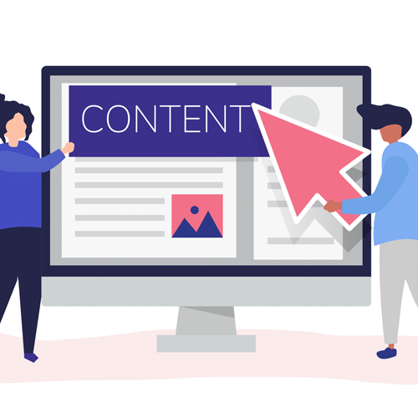
Content
What is Social media….?
Fact on Social media…!
Popular Social Media application.?
Effect of Social media on SLIIT student youth.!
Positive and negative effects of social media use
To use social Media what we will do..?
Conclusion
References

Slide 5
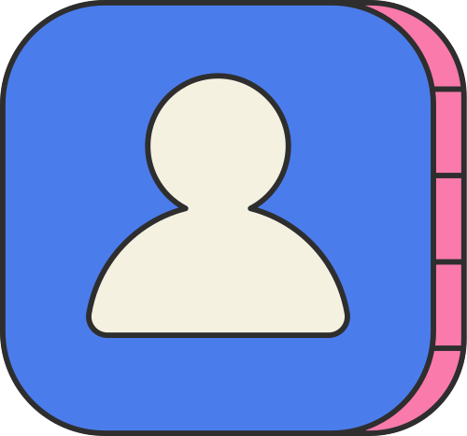

What is Social Media…?
Social media refer to interaction among people in which they create share and or exchange information and ideas in virtual communities and network.
“Social” - Refer to instinctual needs human have to connect with other humans.
“Media” – What human use to make connection with other humans.
“ Social Media” - Social Media use for social interaction.
.

Slide 6

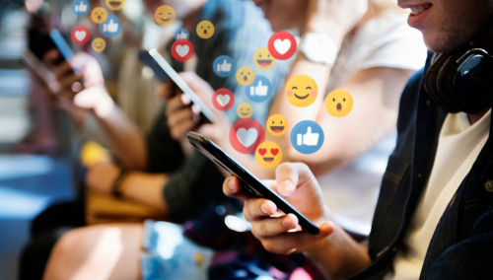
Fact on Social Media in the World..?
Total population 7.9 billions
Total Social Media users 4.234 billions

Slide 7
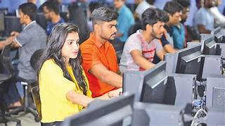
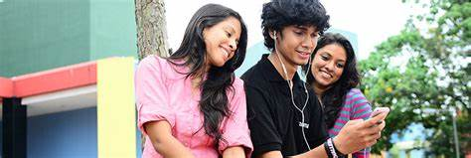
Fact on Social Media in SLIIT
Total Undergraduate Students-9000+
Social Media users in SLIIT 98%

Slide 8
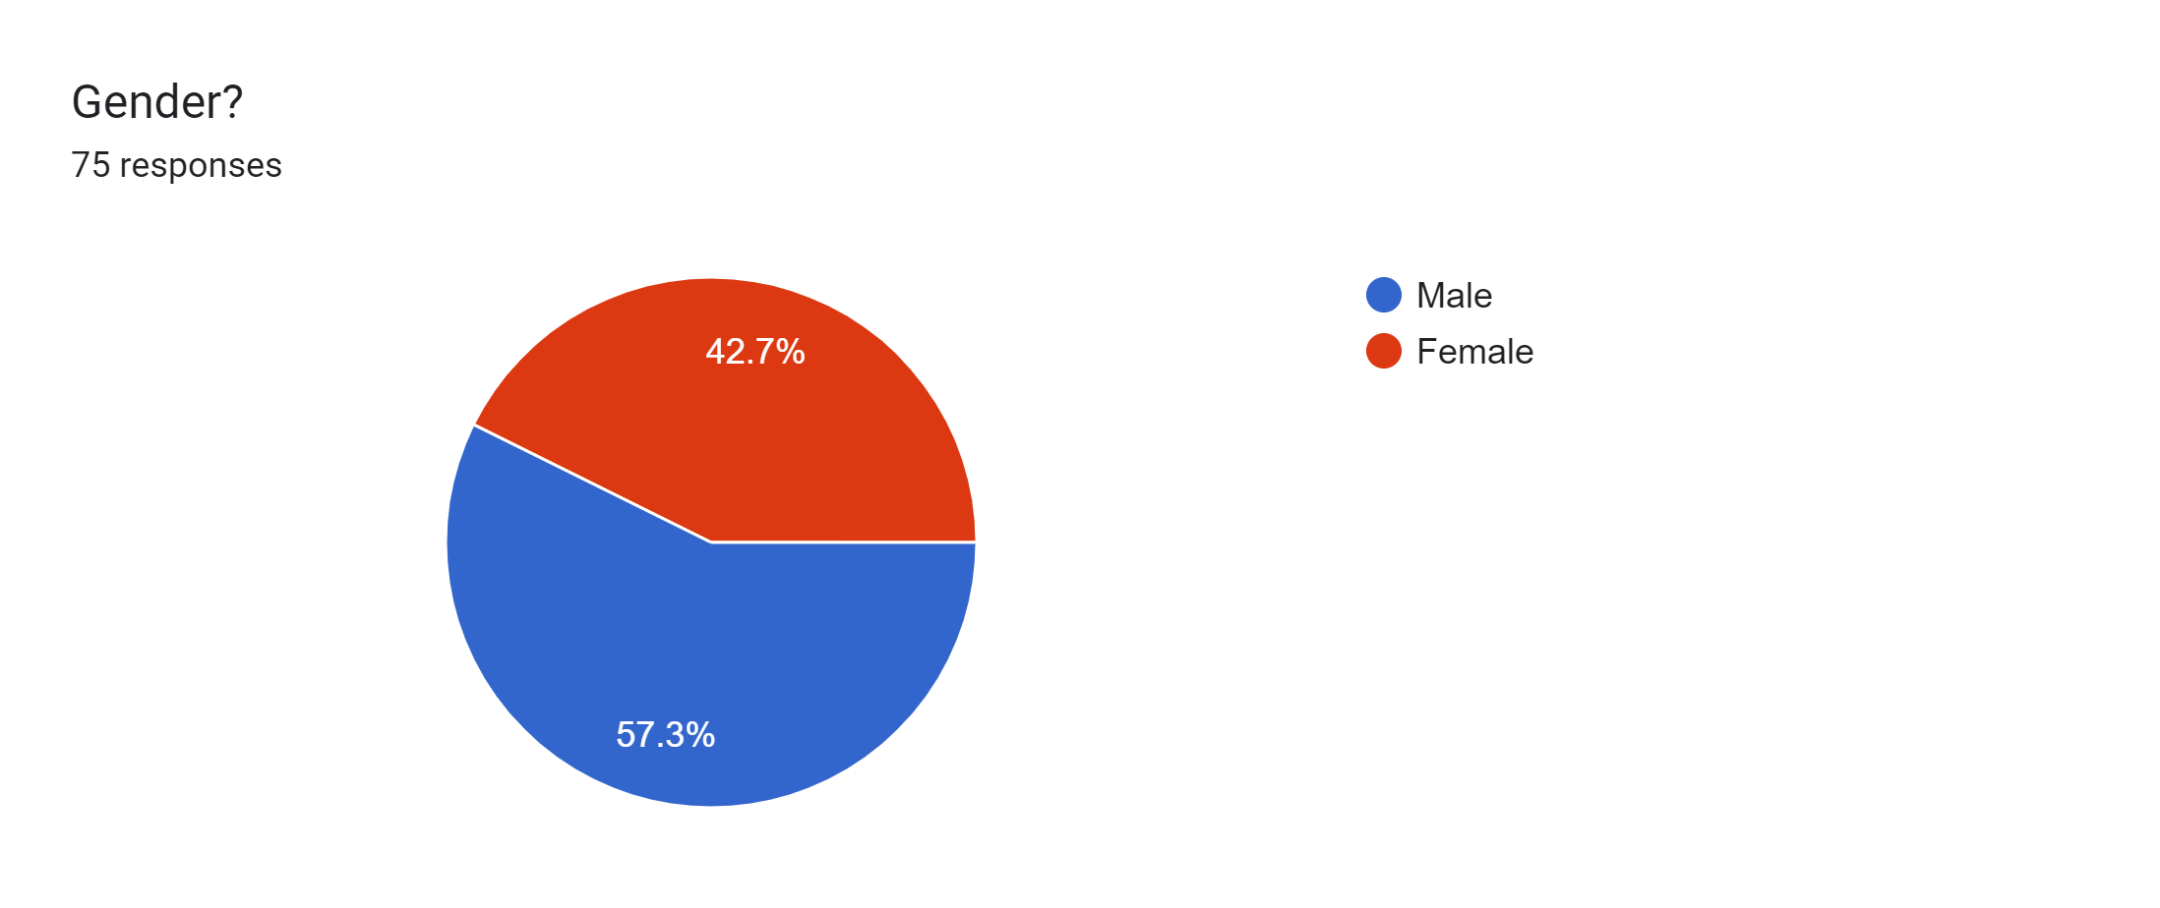
Fact on Social Media in SLIIT
Use of Social Media in Sri Lanka Institute of Information Technology
Social media usage behavior of SLIIT in relation to our survey
According to our sample,
almost 60% male
students
use social media

Slide 9

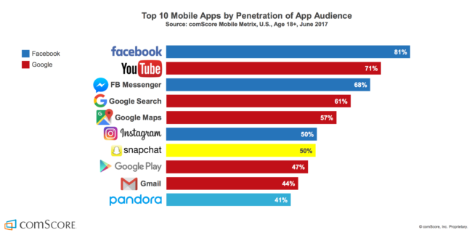
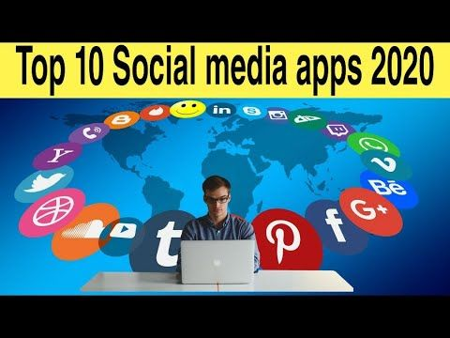
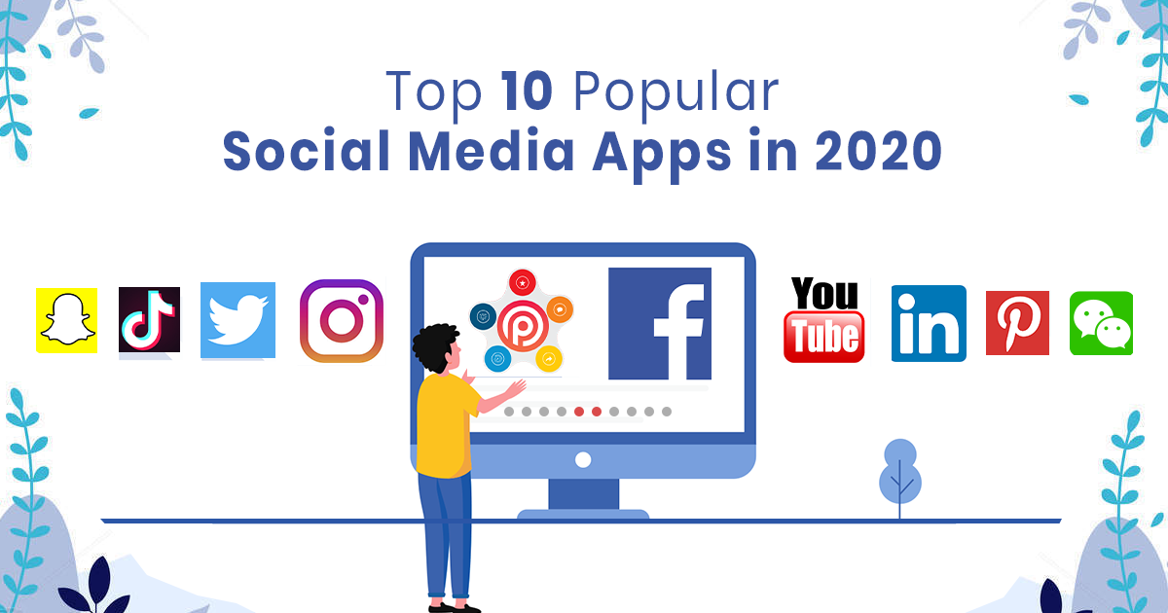
Popular Social Media Applications

Slide 10
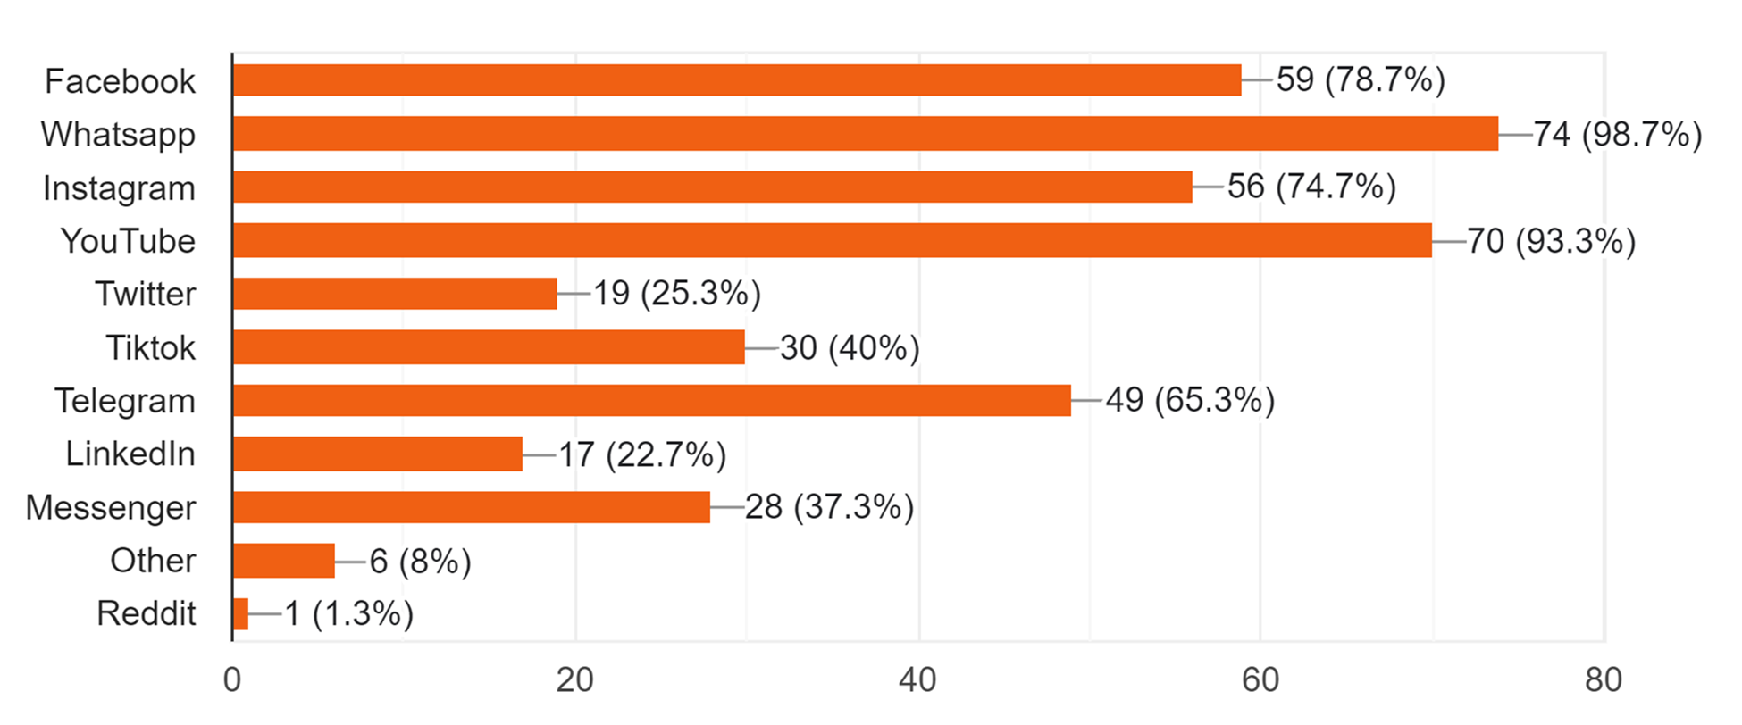
Fact on Social Media in SLIIT
Use of Social Media in Sri Lanka Institute of Information Technology
Social media usage behavior of SLIIT in relation to our survey
In relation to the survey
,
the priorities of using
each social
media are clear
It can be concluded
that
there is more willingness
to use social media like
whatsapp and facebook

Slide 11
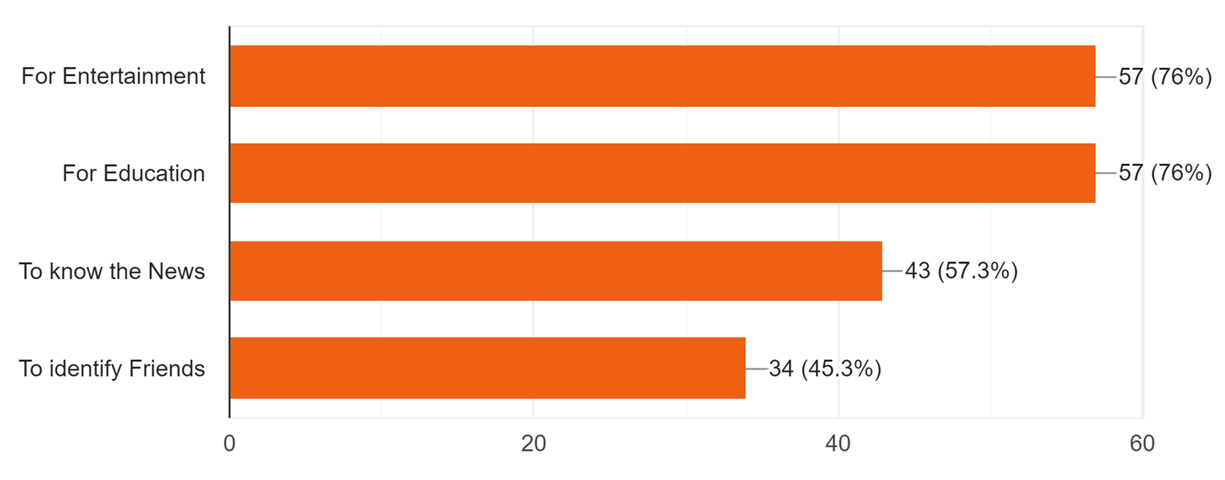
Fact on Social Media in SLIIT
Use of Social Media in Sri Lanka Institute of Information Technology
Social media usage behavior of SLIIT in relation to our survey
Utility of students using
social media

Slide 12
Effect of Social media on SLIIT youth student.!
Social Media is a topic of controversy today. Many feels that is boon but majority feels that is a curse
Mostly people feel that social media has destroyed human interaction.
Social Media has positive as well as negative
.
.

Slide 13
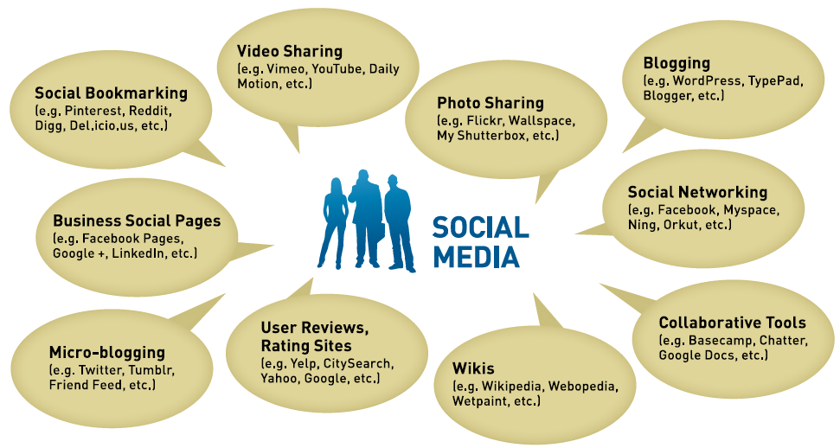
Effect of Social media on SLIIT youth student.!

Slide 14
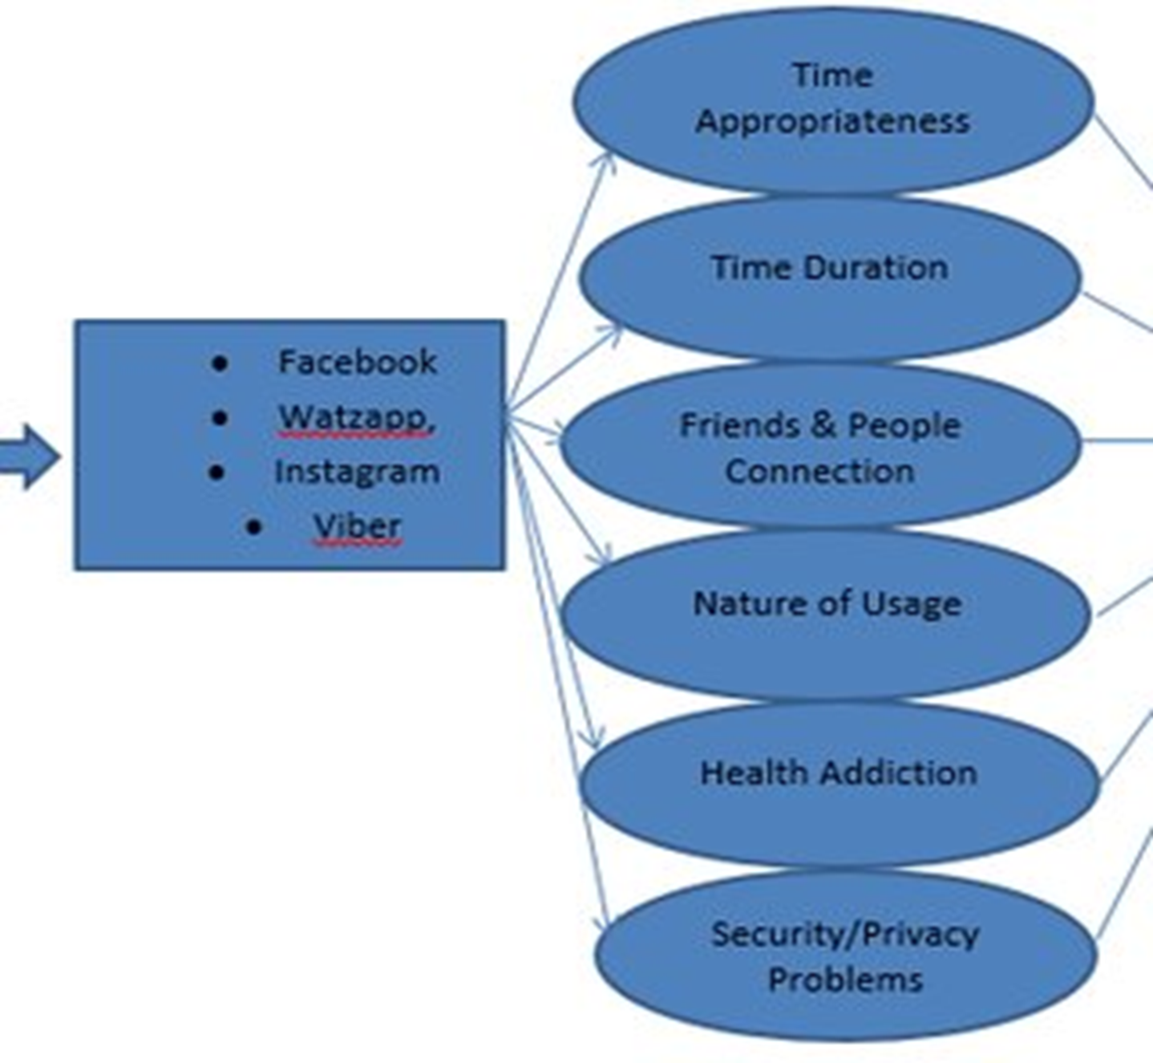

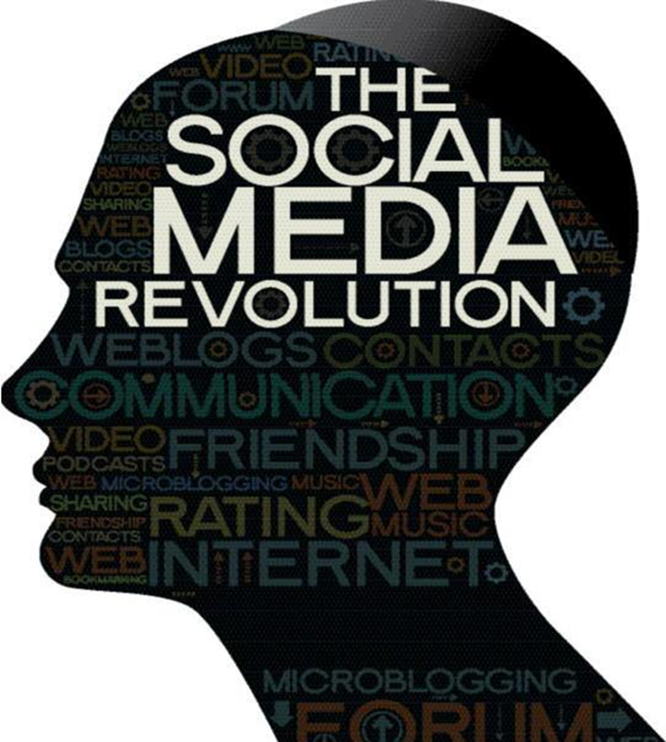
Effect of Social media on SLIIT youth student.!
Facebook
Whatsapp
Instagram
Viber

Slide 15
Positive and negative effects of social media use
Positive Effects
Communication made easy.
Awareness of international issues
Lot of entertainment.
Help in seeking new job offers.
Develop Communication skills & improve knowledge.
Spread the information easily through social media.
Online (Education , Shopping , Booking & Money transaction etc.)
.
.

Slide 16
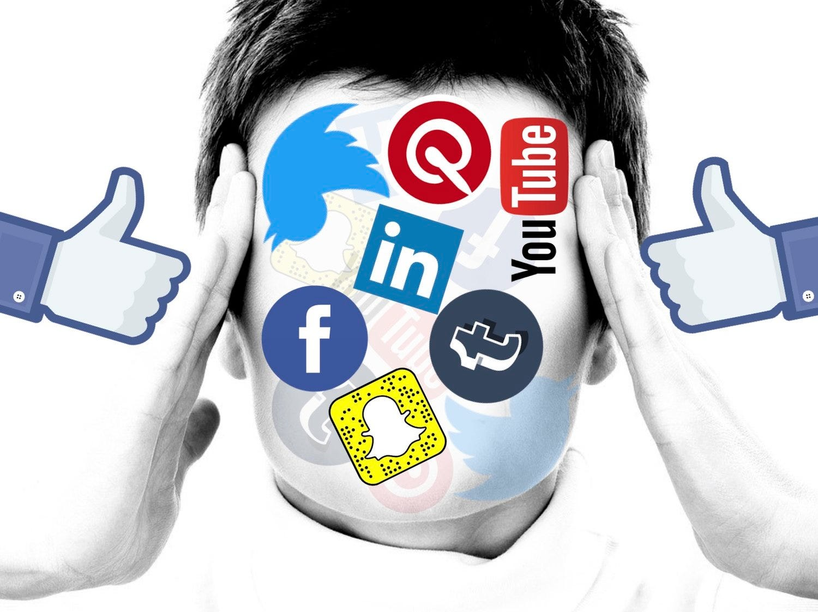
Positive and negative effects of social media use
Negative Effects
Addiction.
Health issues(Psychological Disorder)
Diverting the goals.
Break-up the relations.
Increase in cyber crimes.
Reduction in physical activies.
Prolonged used to se of display screen may weaken eye sight.
.
.

Slide 17
To use social Media what we will do..?
01
02
03
Discover new ideas
&
tends
Continue education
through online
classes
Make good friends
&
learn something

Slide 18
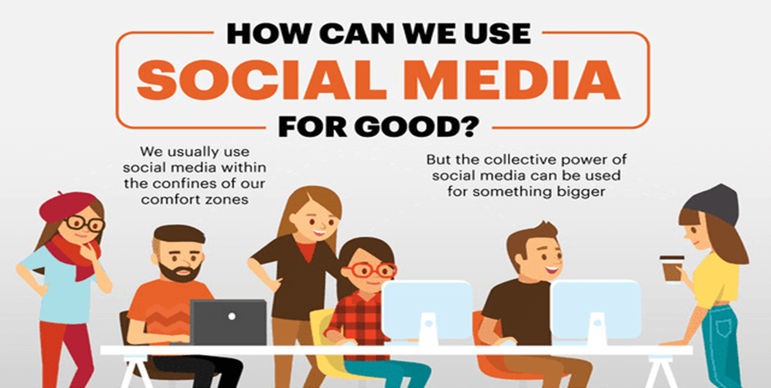
To use social Media what we will do..?
01
02
03
Discover new ideas
&
tends
Continue education
through online
classes
\Make good friends
&
learn something

Slide 19
Conclusion
Recommendations
Based on the findings of the survey, some recommendations for how SLIIT students can use social media in a healthy way ;
Set limits on your social media use. Decide how much time you want to spend on social media each day, and stick to it.
Be mindful of what you post. Think about how your posts might make others feel, and avoid posting anything that is hurtful or offensive.
Take breaks from social media.
If you find yourself spending too much time on social media, take a break for
a few days or even a week.
“Social Media is for you, you are not for social media”

Slide 20

References
[Online]https://en.wikipedia.org/
[News paper] sunday observer
[Online] https://www.nfi.edu/

Slide 21


Groop Details
MLB_15.01_07
WIJEKOON W.M.M.G.K.P
THILAKARATHNE P.L.B.H
JAYALATH J.P.R.J
PERERA K.C.D
HETTIARACHCHI A.N.M

Slide 22
Thank you!

